Slide 1

Scholar Performance
Data Analysis
Melissa Mosier
IST652
Syracuse University

Slide 2
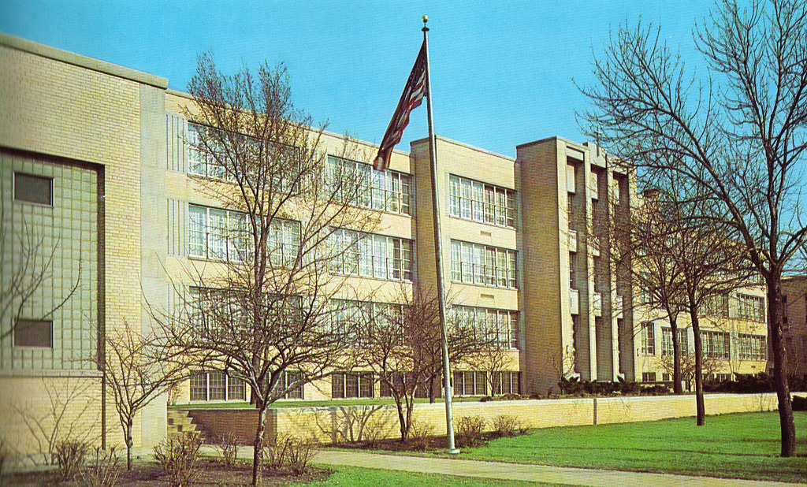
Catalyst Maria High School - History

Slide 3


Catalyst Maria High School - History
Originally Maria High School - est. 1911, closed 2013
Catalyst Maria Charter School - est. 2013 - 2015
Large cultural shift, income shift
I wish I had data from Maria HS. 😭

Slide 4
Data Acquisition & Limitations
Demographics Summary: downloaded from Educlimber and Household Key
Academic Summary: copied from Post-Secondary Google Documents
Testing Summary: copied from Post-Secondary Google Documents
Many repositories for data: PowerSchool, Illuminate, EduClimber, Aspen, Google Docs, (InfiniteCampus), Khan Academy, IXL, Academic Approach
Interns entering data by hand

Slide 5
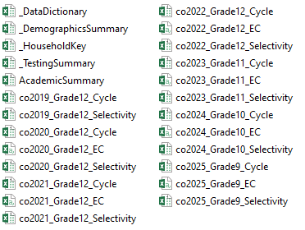
Data Cleaning 😩
Gathering data:
Downloading information from EduClimber
Copying Selectivity information from Post-Secondary and sorting out GPAs
Copying Test Scores from Post-Secondary and saving in separate tabs
Find or create studentIDs
Standardize studentNames and assign them to an ID for cleaning steps.

Slide 6
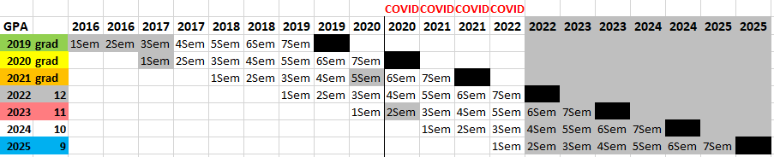
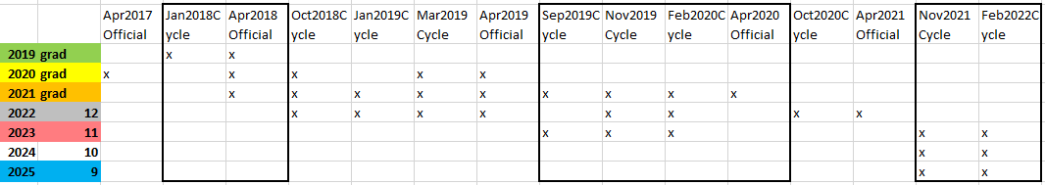
Data Cleaning 😩
Figure out what’s missing and why. What do we do? COVID
Matching studentIDs so I can remove names
Matching up data for summaries

Slide 7
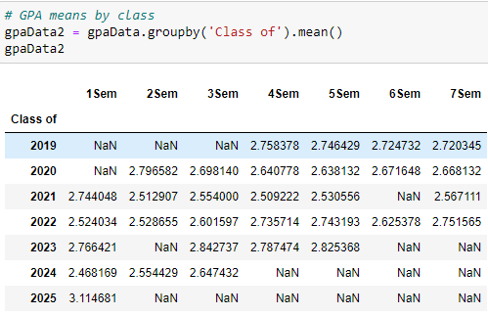
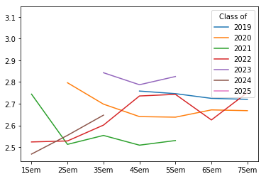
Academics
Average GPA by Class
Missing Semester 8 / Final GPAs
Note the NaN for class of 2021, 2023. And grades for 2022 actually increased!

Slide 8
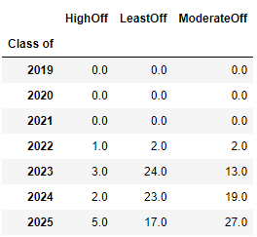
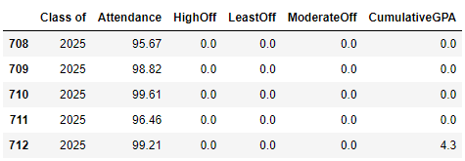
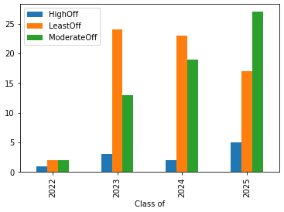
Demographics, Behavior and GPA
Behavior Offenses by Class
Data gathered by Office Staff & Culture Team
Missing data because of move from Powerschool
Seniors (c/o 2022) - well behaved or switch to EC?

Slide 9
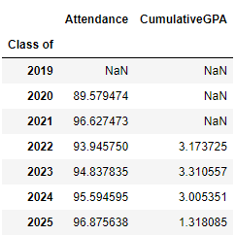
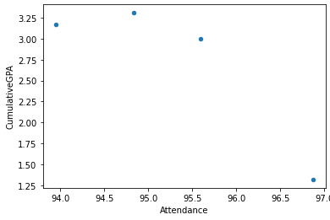
Demographics, Behavior and GPA
Attendance and GPA
Not inclined to put a lot of weight on Freshman GPA (c/o 2025)
(Looks like a trend, may not be reliable)
At least our attendance is in the 90s%! And avg GPA > 3.0…?

Slide 10
Practice and Official Testing (PSAT/SAT)
Seeking predictability of PSAT/SAT from Cycle Testing
Inconsistent records of Cycle Testing
Partnership switched from Khan Academy to Academic Approach
Stopped testing everyone but Juniors during COVID

Slide 11
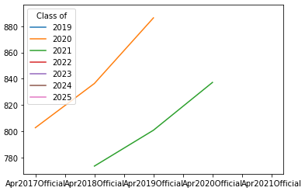
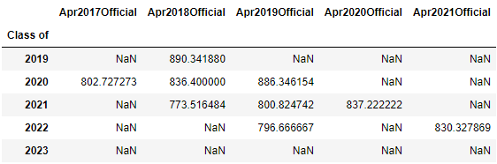
Practice and Official Testing (PSAT/SAT)
Can only compare c/o 2020, 2021, 2022
In 2020:
c/o 2020 were seniors - no effect on scores
c/o 2021 were juniors - scores are lower than 2020
c/o 2022 were sophomores - missing test score
Not a question of coming in lower, COVID

Slide 12
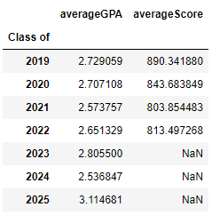
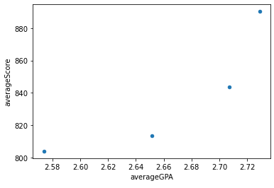
Academics
GPA and PSAT/SAT
Averaged across Official scores, which incl. PSAT & SAT
Does not include Cycle Testing
GPAs are from Post-Secondary Team, so incomplete
Does not include Sem 8
COVID, missing data
Positive trend (predictable) (and income, probably)

Slide 13
Conclusions
Impact of COVID
On Data Management
On Academics and Testing
My school needs a database
Data Management Standardization is not occurring at schools
Within charter/public/private schools, and across CPS, state, and federal levels
SQRP is an attempt across CPS, but….
NAEP Report Cards are an attempt across US, but….

Slide 14
Further Research
I wish I had data from Maria HS. 😭 …and less missing historical data for 2012-present for Catalyst Maria HS.
Incorporate Elementary data (Academics - GPA?; Attendance; NWEA)
Identify sibling trends
Geolocation based on address, income from census block / zipcode
Note: The SAT is going digital and removing parts of the math section. Let’s see how this goes!

Slide 15
Thank you!

